Slide 1

Voted private label PRODUCT OF THE YEAR 2021 online survey in slovenia
Honey
Nielsen
February 2021

Slide 2
context
The logo “Voted Product of the Year”, which is used annually by dozens of products in European supermarkets and shops, is the result of a strict selection process and exists now as well for Private Label. Every year, (branded) manufacturers in more than 40 countries subject their renewed and innovative products to the strict judgement of consumers.
In Slovenia, more than thousand people give their opinion on products that are submitted to them and elect their Products of the Year. This is the case in multiple categories: personal hygiene, household cleaning, accessories, etc. The logo displayed on their packaging reflects the novelty and innovation that these hundreds of consumers have noticed and judged later on.
Each product is evaluated individually and its results are compared to the participating products in its category.

Slide 3
The 4 Steps of the Election Process
Submission: producers propose to the Management of “Voted Product of the Year”, products they particularly consider as innovative and attractive.
Screening for the competition: all suggested products are analyzed by the Committee of Experts, which are then evaluated and approved.
The selected products: the selected products are then subject to an evaluation by hundreds of consumers (Nielsen: Panel/Analysis). Product testing is done by treetz based on a tester panel of around 120 respondents per product.
Results and the Awards ceremony: products elected by the public are awarded Voted Private Label Product of the Year for a period of one year.

Slide 4
METHODOLOGY
Online survey via Nielsen panels.
Men and women (18 – 64 years old) who are responsible for the shopping
For each category there is a aim of strongly representative sample. The invites will be sent out to a random initial sample that is representative of the population in age, gender and region. The structure of the final sample will be determined by natural fall-out.
Products in the survey will be evaluated one-by-one (in random order)

Slide 5

questionnaire
Awareness and source of awareness
Attractiveness
Input factors for final score
Perceived novelty/innovation
Purchase Intent

Slide 6
SUMMARY

Slide 7



SUMMARY - Honey
              57% have purchased the category. They are mostly females 25-54 years old with children in household.
              Main reasons to purchase products of the category are the taste and flavor of the products.
              The store is the main awareness driver in the category.
Notes:
Check name of the categories.

Slide 8
PROFILE

Slide 9
57% haVE bought Honey in the last 6 months
Have you bought Honey in the last 6 months?
57%
YES
Total Sample
N=525
Notes:
Q3 “Did Purchase”

Slide 10
Category buyers profile 1/2
Total Sample N=299
Notes:
Q1 & Q2

Slide 11
Category buyers profile 2/2
Total Sample N=299
Notes:
Q22, Q23 & Q24

Slide 12
The taste and flavor are the MAIN REASON TO BUY Honey
Total Sample
N=102
Notes:
Q4

Slide 13
Product performance

Slide 14
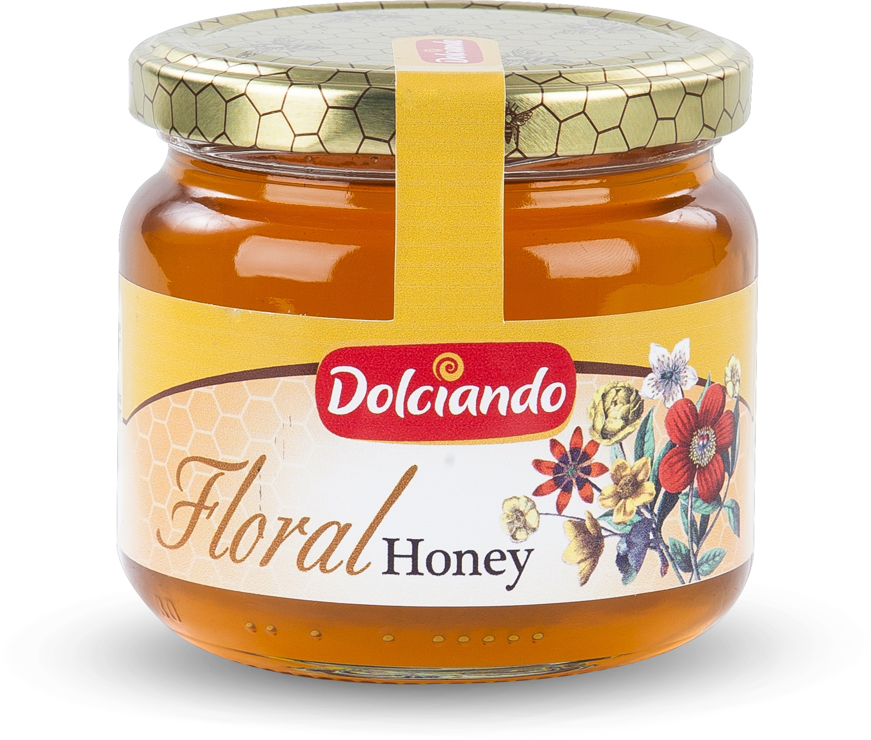
DOLCIANO CVETLIČNI MED 450g
Točeni cvetlični med preverjene kakovosti. Cvetlični med je prepoznam po svetli barvi, prijetnemu vonju travniških cvetlic in prijetnemu sladkemu okusu. Med je pakiran v 450 gramskem steklenem kozarcu ergonomske oblike.

Slide 15
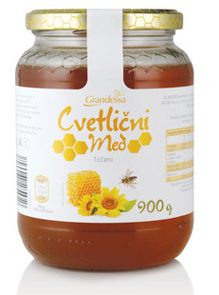
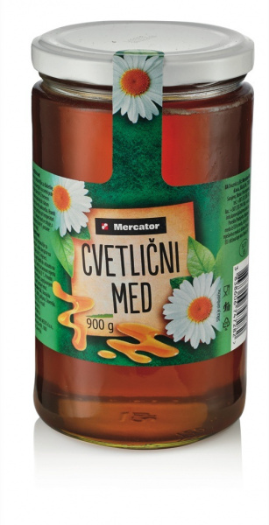
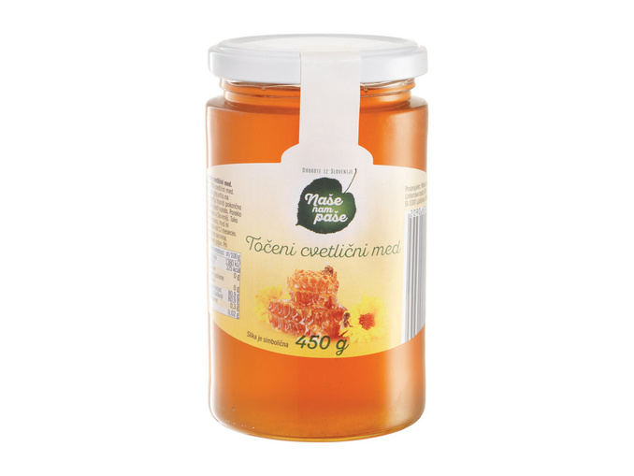
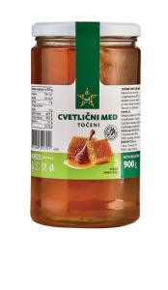
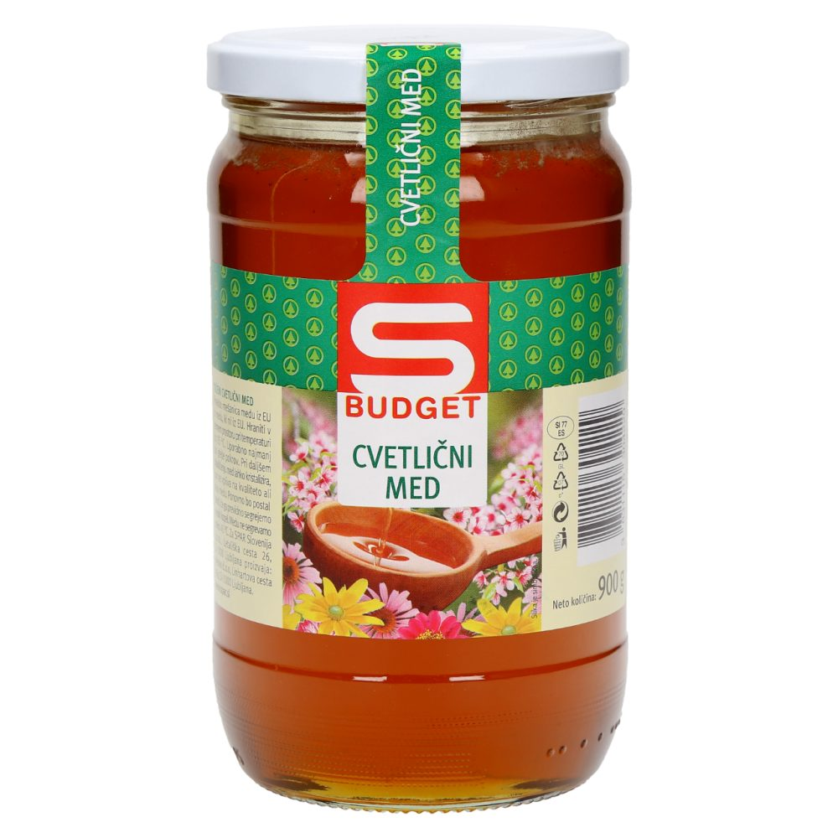
Grandessa Cvetlični med Hofer
Cvetlični med Mercator
Naše nam paše Lidl
Točeni cvetlični med TUŠ
S Budget cvetlični med SPAR

Slide 16
DOLCIANO CVETLIČNI MED 450g is Voted private label product of the year 2021 in the category Honey
Competitor Average
5.78/10
5.56/10
5.67/10
6.26/10
5.07/10
5.43/10
5.37/10
ATTRACTIVENESS | 6.24 | 5.77 | 5.84 | 6.53 | 5.25 | 5.67 | 5.58
INNOVATION | 5.85 | 5.41 | 5.55 | 6.03 | 4.90 | 5.28 | 5.30
PURCHASE INTENT | 5.22 | 5.55 | 5.66 | 6.30 | 5.13 | 5.40 | 5.26
(FINAL Score = SUM of 30% ATTRACTIVENESS, 40% innovation, 30% purchase intent)
Benchmark: 5,67
Based on 127 products in the Slovenian market
Notes:
Category list

Slide 17
ATTRACTIVENESS
Can you indicate to what extent you find this product attractive?
N=102
Scale :
0= not at all attractive
10= very attractive
Competitor Average
Benchmark: 5,93
Based on 127 products in the Slovenian market
Notes:
Q7

Slide 18
CROSSING WITH SOCIO DEMOGRAPHICS - attractiveness
Competitor Average
Gender
Male | 6.30 | 5.82 | 5.91 | 6.56 | 5.28 | 5.67 | 5.70
Female | 6.19 | 5.74 | 5.80 | 6.51 | 5.22 | 5.66 | 5.49
Age
18-24 years | 7.15 | 6.05 | 5.77 | 7.00 | 5.77 | 5.69 | 6.00
25-39 years | 6.55 | 5.73 | 6.15 | 6.48 | 5.21 | 5.55 | 5.24
40-54 years | 5.97 | 5.79 | 5.73 | 6.51 | 5.05 | 5.97 | 5.68
55-64 years | 5.58 | 5.63 | 5.58 | 6.32 | 5.32 | 5.26 | 5.68
Region
Mura | 7.60 | 6.56 | 7.00 | 7.80 | 5.80 | 6.40 | 5.80
Drava | 6.89 | 5.82 | 5.67 | 6.72 | 5.06 | 5.83 | 5.83
Carinthia | 4.67 | 5.27 | 4.67 | 6.00 | 5.67 | 5.00 | 5.00
Savinja | 5.78 | 5.74 | 5.33 | 6.28 | 5.56 | 5.33 | 6.22
Central Sava | 6.08 | 4.82 | 5.46 | 6.46 | 3.77 | 4.38 | 4.00
Lower Sava | 6.80 | 6.84 | 7.20 | 7.60 | 6.00 | 7.20 | 6.20
Southeast Slovenia | 6.50 | 6.28 | 6.50 | 6.88 | 5.75 | 6.00 | 6.25
Littoral – Inner Carniola | 0.00 | 0.00 | 0.00 | 0.00 | 0.00 | 0.00 | 0.00
Central Slovenia | 6.19 | 6.10 | 6.13 | 6.81 | 5.50 | 6.50 | 5.56
Upper Carniola | 6.71 | 6.43 | 6.29 | 6.43 | 6.86 | 6.57 | 6.00
Gorizia | 5.50 | 2.30 | 3.00 | 3.00 | 1.50 | 2.00 | 2.00
Coastal – Karst | 4.86 | 5.40 | 6.00 | 5.43 | 4.86 | 5.00 | 5.71
Notes:
Q7

Slide 19
innovation
Can you indicate to what extent you find this product innovative?
N=102
Scale :
0= not at all innovative
10= very innovative
Competitor Average
Benchmark: 5,57
Based on 127 products in the Slovenian market
Notes:
Q8

Slide 20
CROSSING WITH SOCIO DEMOGRAPHICS – innovation
Competitor Average
Gender
Male | 5.93 | 5.38 | 5.63 | 5.81 | 4.88 | 5.28 | 5.30
Female | 5.80 | 5.44 | 5.49 | 6.19 | 4.92 | 5.29 | 5.31
Age
18-24 years | 6.85 | 5.97 | 6.23 | 6.62 | 5.15 | 5.77 | 6.08
25-39 years | 6.09 | 5.50 | 5.88 | 6.12 | 5.00 | 5.45 | 5.06
40-54 years | 5.68 | 5.29 | 5.27 | 5.95 | 4.76 | 5.19 | 5.30
55-64 years | 5.11 | 5.12 | 5.05 | 5.63 | 4.84 | 4.84 | 5.21
Region
Mura | 6.40 | 5.96 | 6.00 | 6.40 | 6.20 | 5.80 | 5.40
Drava | 6.61 | 5.48 | 5.56 | 5.78 | 5.00 | 5.56 | 5.50
Carinthia | 5.00 | 5.33 | 5.33 | 5.67 | 5.67 | 5.00 | 5.00
Savinja | 5.78 | 5.49 | 5.50 | 6.11 | 4.94 | 5.17 | 5.72
Central Sava | 5.31 | 4.40 | 5.08 | 5.77 | 3.38 | 3.85 | 3.92
Lower Sava | 6.60 | 6.52 | 6.80 | 7.60 | 5.20 | 6.60 | 6.40
Southeast Slovenia | 6.25 | 5.95 | 6.00 | 6.25 | 5.63 | 5.75 | 6.13
Littoral – Inner Carniola | 0.00 | 0.00 | 0.00 | 0.00 | 0.00 | 0.00 | 0.00
Central Slovenia | 5.81 | 5.55 | 5.44 | 6.38 | 5.00 | 5.69 | 5.25
Upper Carniola | 6.00 | 6.00 | 6.00 | 6.14 | 5.86 | 6.14 | 5.86
Gorizia | 3.00 | 2.40 | 3.00 | 3.00 | 1.50 | 2.50 | 2.00
Coastal – Karst | 4.86 | 5.14 | 5.43 | 5.43 | 4.86 | 4.86 | 5.14
Notes:
Q8

Slide 21
PURCHase intent
Can you indicate to what extent you intend to purchase this product?
N=102
Scale :
0= I certainly would not buy
10= I would definitely buy
Competitor Average
Benchmark: 5,53
Based on 127 products in the Slovenian market
Notes:
Q9

Slide 22
CROSSING WITH SOCIO DEMOGRAPHICS – purchase intent
Competitor Average
Gender
Male | 4.98 | 5.46 | 5.63 | 6.12 | 5.26 | 5.02 | 5.28
Female | 5.39 | 5.62 | 5.68 | 6.44 | 5.03 | 5.68 | 5.25
Age
18-24 years | 5.92 | 6.00 | 6.23 | 6.69 | 5.77 | 6.23 | 5.08
25-39 years | 5.36 | 5.61 | 5.73 | 6.21 | 5.30 | 5.39 | 5.39
40-54 years | 5.27 | 5.45 | 5.59 | 6.35 | 4.81 | 5.35 | 5.16
55-64 years | 4.37 | 5.34 | 5.26 | 6.11 | 5.00 | 4.95 | 5.37
Region
Mura | 5.60 | 6.08 | 6.20 | 7.00 | 5.60 | 5.80 | 5.80
Drava | 6.06 | 5.90 | 6.11 | 6.44 | 5.44 | 6.17 | 5.33
Carinthia | 4.67 | 5.00 | 5.00 | 6.00 | 5.00 | 4.67 | 4.33
Savinja | 5.50 | 5.91 | 5.72 | 6.89 | 5.44 | 5.33 | 6.17
Central Sava | 4.62 | 4.35 | 4.38 | 6.08 | 3.77 | 4.08 | 3.46
Lower Sava | 6.20 | 6.20 | 6.60 | 7.20 | 4.80 | 7.00 | 5.40
Southeast Slovenia | 5.75 | 6.40 | 6.25 | 6.63 | 5.88 | 6.13 | 7.13
Littoral – Inner Carniola | 0.00 | 0.00 | 0.00 | 0.00 | 0.00 | 0.00 | 0.00
Central Slovenia | 4.13 | 5.15 | 5.38 | 5.56 | 5.13 | 4.75 | 4.94
Upper Carniola | 5.14 | 6.14 | 6.43 | 6.29 | 6.14 | 6.71 | 5.14
Gorizia | 3.00 | 2.50 | 3.50 | 3.50 | 1.00 | 2.00 | 2.50
Coastal – Karst | 5.29 | 5.57 | 5.71 | 6.00 | 5.29 | 5.29 | 5.57
Notes:
Q9

Slide 23
Source of innovation, TouchpointS

Slide 24
Awareness of products
Have you seen this product?
DOLCIANO CVETLIČNI MED 450g
Competitor
Average
Grandessa Cvetlični med Hofer
Naše nam paše Lidl
26%
49%
57%
34%
S Budget cvetlični med SPAR
Cvetlični med Mercator
Točeni cvetlični med TUŠ
N=102
40%
50%
66%
Notes:
Q5

Slide 25
CROSSING WITH SOCIO DEMOGRAPHICS – AWARENESS
Competitor Average
Gender
Male | 26% | 48% | 35% | 53% | 67% | 40% | 47%
Female | 27% | 50% | 34% | 59% | 64% | 41% | 53%
Age
18-24 years | 31% | 51% | 23% | 85% | 77% | 38% | 31%
25-39 years | 30% | 42% | 24% | 48% | 61% | 33% | 42%
40-54 years | 24% | 54% | 49% | 54% | 68% | 46% | 54%
55-64 years | 21% | 53% | 32% | 58% | 63% | 42% | 68%
Region
Mura | 0% | 44% | 40% | 60% | 60% | 20% | 40%
Drava | 11% | 48% | 33% | 67% | 72% | 28% | 39%
Carinthia | 33% | 60% | 33% | 67% | 67% | 67% | 67%
Savinja | 44% | 54% | 44% | 61% | 67% | 28% | 72%
Central Sava | 15% | 37% | 31% | 54% | 38% | 38% | 23%
Lower Sava | 40% | 68% | 60% | 60% | 80% | 80% | 60%
Southeast Slovenia | 25% | 58% | 25% | 50% | 88% | 63% | 63%
Littoral – Inner Carniola | 0% | 0% | 0% | 0% | 0% | 0% | 0%
Central Slovenia | 25% | 56% | 31% | 63% | 75% | 50% | 63%
Upper Carniola | 29% | 43% | 43% | 57% | 43% | 43% | 29%
Gorizia | 0% | 20% | 0% | 0% | 50% | 50% | 0%
Coastal – Karst | 57% | 40% | 14% | 29% | 71% | 29% | 57%
Notes:
Q5

Slide 26
the store is the main source of awareness.
You indicated you have seen this product before. Where did you see this product?
Notes:
Q6

Slide 27
USAGE

Slide 28
Product usage
Have you used this product?
Competitor
Average
DOLCIANO CVETLIČNI MED 450g
Grandessa Cvetlični med Hofer
Naše nam paše Lidl
51%
26%
60%
57%
S Budget cvetlični med SPAR
Cvetlični med Mercator
Točeni cvetlični med TUŠ
40%
49%
51%
Notes:
Q10

Slide 29
CROSSING WITH SOCIO DEMOGRAPHICS – usage
Competitor Average
Gender
Male | 18% | 54% | 73% | 57% | 41% | 41% | 60%
Female | 31% | 49% | 50% | 57% | 39% | 54% | 45%
Age
18-24 years | 25% | 52% | 67% | 55% | 30% | 60% | 50%
25-39 years | 30% | 60% | 63% | 63% | 50% | 36% | 86%
40-54 years | 22% | 47% | 61% | 55% | 36% | 53% | 30%
55-64 years | 25% | 49% | 50% | 55% | 42% | 50% | 46%
Region
Mura | 0% | 67% | 50% | 67% | 67% | 100% | 50%
Drava | 0% | 65% | 83% | 58% | 38% | 60% | 86%
Carinthia | 100% | 30% | 0% | 50% | 50% | 0% | 50%
Savinja | 38% | 52% | 50% | 91% | 33% | 40% | 46%
Central Sava | 50% | 54% | 50% | 71% | 40% | 40% | 67%
Lower Sava | 0% | 23% | 33% | 33% | 0% | 50% | 0%
Southeast Slovenia | 50% | 70% | 100% | 75% | 57% | 40% | 80%
Littoral – Inner Carniola | 0% | 0% | 0% | 0% | 0% | 0% | 0%
Central Slovenia | 25% | 36% | 60% | 20% | 33% | 25% | 40%
Upper Carniola | 0% | 52% | 67% | 25% | 67% | 100% | 0%
Gorizia | 0% | 20% | 0% | 0% | 0% | 100% | 0%
Coastal – Karst | 0% | 72% | 100% | 50% | 60% | 100% | 50%
Notes:
Q10

Slide 30
SATISFACTION
How satisfied were you with the product?
Scale:
0= not at all satisfied
10= very satisfied
Competitor Average
Benchmark: 7,67
Based on 127 products in the Slovenian market
Notes:
Q11

Slide 31
CROSSING WITH SOCIO DEMOGRAPHICS – satisfaction
Competitor Average
Gender
Male | 8.50 | 7.05 | 6.64 | 7.85 | 7.33 | 4.86 | 7.67
Female | 6.60 | 7.56 | 8.10 | 8.20 | 7.13 | 7.77 | 7.21
Age
18-24 years | 7.00 | 7.89 | 5.50 | 8.50 | 9.00 | 6.00 | 8.00
25-39 years | 7.67 | 7.15 | 7.60 | 8.00 | 7.10 | 6.25 | 7.83
40-54 years | 5.00 | 7.43 | 7.64 | 7.91 | 7.11 | 7.22 | 6.50
55-64 years | 10.00 | 7.09 | 7.00 | 8.00 | 6.60 | 6.75 | 7.33
Region
Mura | 0.00 | 7.92 | 10.00 | 8.50 | 7.00 | 9.00 | 10.00
Drava | 0.00 | 7.59 | 8.40 | 8.43 | 6.80 | 7.67 | 6.50
Carinthia | 7.00 | 9.00 | 0.00 | 10.00 | 7.00 | 0.00 | 10.00
Savinja | 6.33 | 7.19 | 4.75 | 8.10 | 8.00 | 5.00 | 8.33
Central Sava | 10.00 | 6.19 | 7.50 | 7.60 | 6.00 | 5.00 | 6.00
Lower Sava | 0.00 | 9.33 | 9.00 | 9.00 | 0.00 | 9.50 | 0.00
Southeast Slovenia | 4.00 | 8.26 | 6.00 | 6.33 | 7.25 | 5.50 | 8.25
Littoral – Inner Carniola | 0.00 | 0.00 | 0.00 | 0.00 | 0.00 | 0.00 | 0.00
Central Slovenia | 10.00 | 6.97 | 7.67 | 7.50 | 8.00 | 6.50 | 7.00
Upper Carniola | 0.00 | 8.25 | 9.00 | 10.00 | 8.50 | 8.33 | 0.00
Gorizia | 0.00 | 1.00 | 0.00 | 0.00 | 0.00 | 1.00 | 0.00
Coastal – Karst | 0.00 | 6.29 | 6.00 | 8.00 | 6.00 | 7.00 | 5.50
Notes:
Q11

Slide 32
Preference for a product
Suppose you have to choose between one of these products. Which product would you choose?
DOLCIANO CVETLIČNI MED 450g
Competitor Total
84%
Grandessa Cvetlični med Hofer
Naše nam paše Lidl
16%
13%
31%
S Budget cvetlični med SPAR
Cvetlični med Mercator
13%
Točeni cvetlični med TUŠ
N=102
8%
20%
Notes:
Q13

Slide 33
THE MAIN REASON WHY PEOPLE DON’T BUY the product IS the lack of knowledge and the preference for other brands
N=16*
Small base size (n<20)
Notes:
Q12

Slide 34
THE MAIN REASON WHY PEOPLE DON’T BUY competitor products is the preference for other brands
Competitor Average
N=16*
Small base size (n<20)
Notes:
Q12

Slide 35
THE MAIN REASON WHY PEOPLE DON’T BUY the product IS the preference for other brands
N=13*
Small base size (n<20)
Notes:
Q12

Slide 36
THE MAIN REASON WHY PEOPLE DON’T BUY the product IS the lack of knowledge
N=21
Notes:
Q12

Slide 37
THE MAIN REASON WHY PEOPLE DON’T BUY the product IS is the preference for other brands
N=38
Notes:
Q12

Slide 38
THE MAIN REASON WHY PEOPLE DON’T BUY the product IS the preference for other brands
N=16*
Small base size (n<20)
Notes:
Q12

Slide 39
THE MAIN REASON WHY PEOPLE DON’T BUY the product IS the preference for other brands
N=21
Notes:
Q12

Slide 40
THE MAIN REASON WHY PEOPLE DON’T use the category IS that they do not consume honey besides other reasons
N=107
Notes:
Q6a

Slide 41
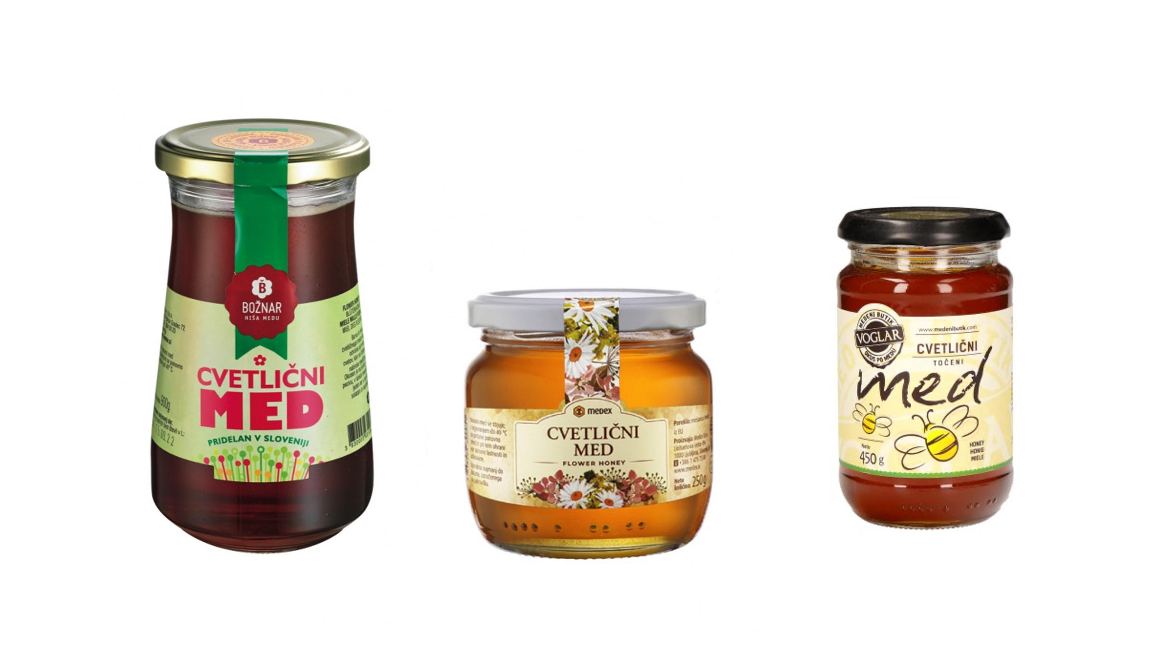
Private label vs A Brand RATING
How would you rate the private label product compared to the displayed A-brand?
N=102
Scale :
1= A lot worse
10= A lot better
Cvetlični med Medex,...

Slide 42
Private label vs A brand PREFERENCE
And which of the two products would you buy?
DOLCIANO CVETLIČNI MED 450g
Cvetlični med Medex,...
None of these
19%
68%
14%
N=102

Slide 43
APPENDIX

Slide 44
Questionnaire
Sociodemographic questions
Which categories did you purchase in the last 6 months?
What are the 3 most important reasons for you to choose a product in the category <insert category>?
Have you seen this product?
You indicated you have seen this product before. Where did you see this product?
Can you indicate to what extent you find this product attractive?
Can you indicate to what extent you find this product innovative?
Can you indicate to what extent you intend to purchase this product?
Have you used this product?
How satisfied were you with the product?
What is the main reason for which you have not used this product?
What is your main reason for not using <insert category> products yet?

